Slide 1
Interview Report
Presented by: Dipesh Tha Shrestha
Presented To: Akash Deo

Slide 2
I went to my friend house to take a interview about the website. I asked him some question about that website. Therefore, the answer provided by friend are given below in the slides.

Slide 3
AnimeKisa, what is it?
AnimeKisa is a place where you can enjoy anime that usually would not be available to you due to region restrictions on regular platforms such as CrunchyRoll. AnimeKisa however acts like a search engine similarly to google, it uses does bots to crawl several places on the internet to get links to third party players that host the files, the difference is that AnimeKisa focuses only on anime and in organizing it in a nice way.

Slide 4
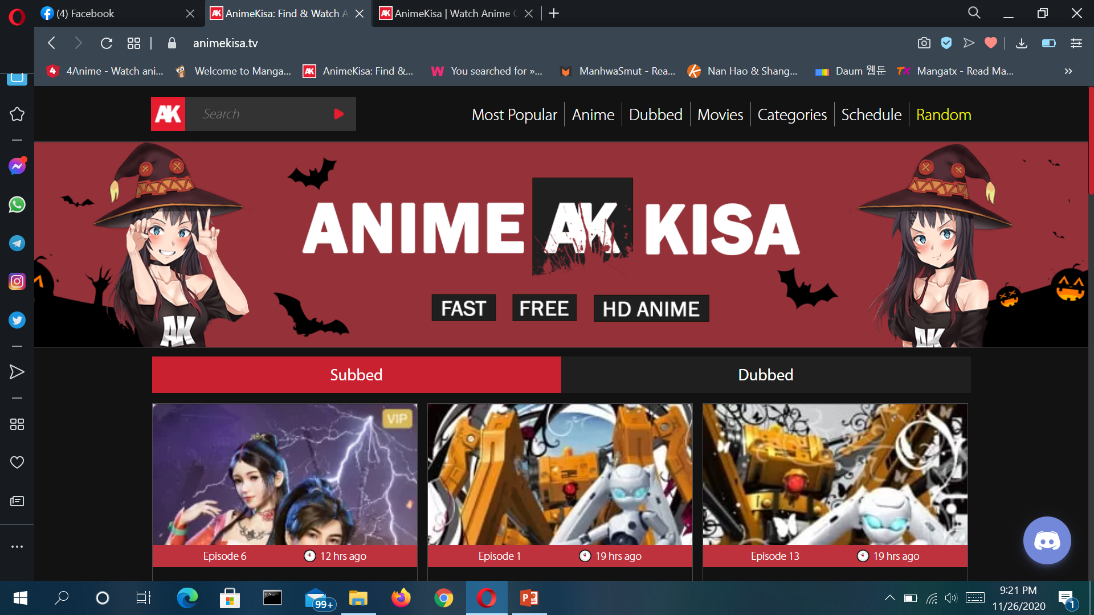
Homepage of animekisa

Slide 5
Are there any problem in his website?
Apart from the slow loading speed, there is not much else to complain about in this free anime website. With easy navigation and accessibility to newly released episodes, Animekisa is indeed one of the best free anime websites available online today.

Slide 6
Is there any feature that make animekisa better or unique than other anime website?
Latest anime title release
Available in high 1080P resolution
Anime community
24/7 live chat
Choose from multiple source points
Easy navigation
Catchy interface

Slide 7
What are some pros and cons of this website?
Pros:
Easy categories for advanced search
Download for offline viewing
Free dubbed versions
Cons:
Pop-up ads
Slow video loading

Slide 8
Conclusion
This is an exciting time to be an anime fan. Anime has never been as accessible as it is today. Anybody can now enjoy their favorite show uncensored from the comfort of their own homes whenever they like.
As for our recommendations, if you are looking for a fast Anime streaming website with a huge collection of both old and new anime titles, then opt for Funimation or Crunchyroll if you don’t mind paying a small subscription fee.
If you are frugal with money, then there are great free options like 9Anime and Gogoanime that will satisfy your hunger for good anime without burdening your pockets.
We hope you enjoyed this comparison and review of popular Anime Websites. For more such reviews, use the search box on the top right corner of this page.

